Slide 1


Slide 2

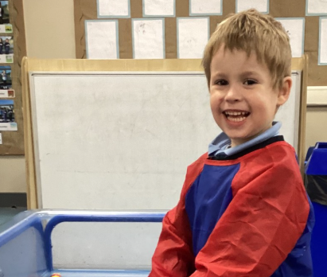
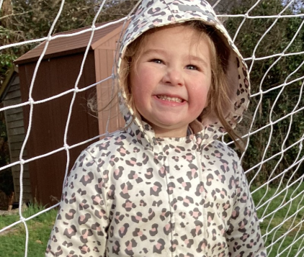
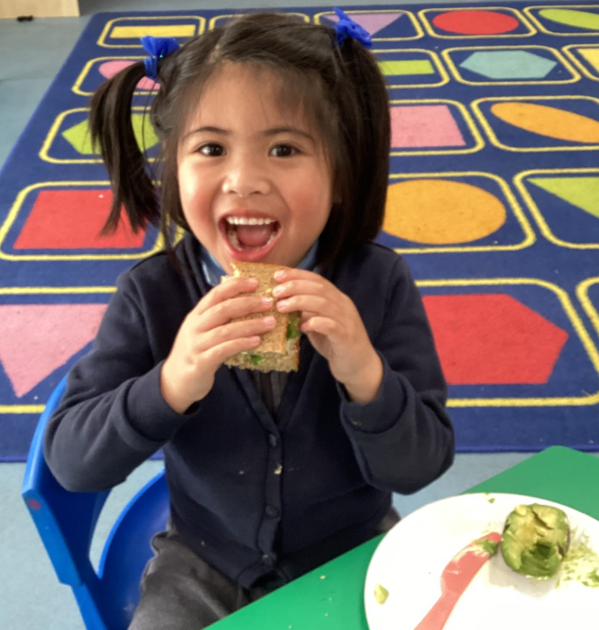
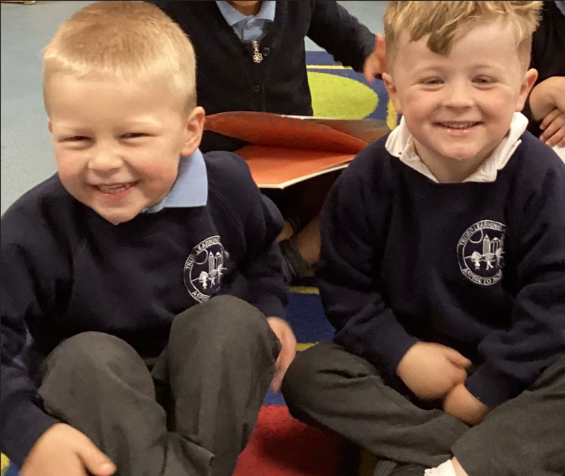
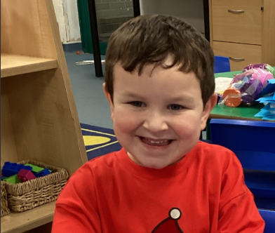
Welcome to the
TLA family!

Slide 3
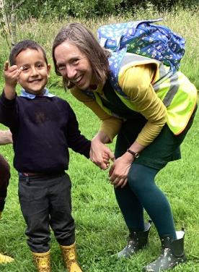

Mrs Spurgeon
EYFS Lead and Class Teacher
Science Lead and Sustainability Lead

Slide 4
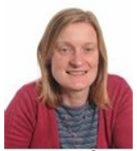
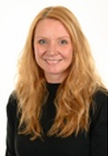
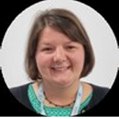
Senior Leadership Team
Mrs Lane
Assistant Head of School
Mrs Baxter
SENCO
Mrs Smith
Head of School

Slide 5
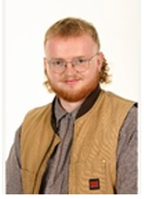
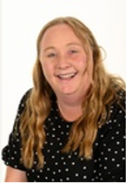
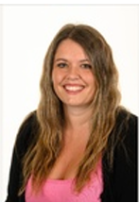
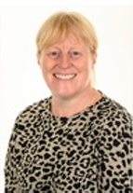
Classroom Support Staff
Mr Birnie Miss Coon Mrs Fugler Miss Jasper
Teaching Assistants

Slide 6
Starting School for Reception Children
Part-time for two days only:
Monday, 7th September: 9.30am – 11.30am
Tuesday, 8th September: 9.30am – 12.30pm with lunch
Full-time onwards:
Wednesday, 9th September: 8.30 – 3.10pm

Slide 7
What will happen on Monday 7th September
at 9.30am?
Mrs Spurgeon will welcome your child at the Nursery/Reception door.
Please give your child their bag, coat and bottle before you reach the door so that they can quickly say goodbye to you.
If your child is upset, please know we will reassure, comfort and settle them.
  We will always ring you if we need you.
One of the teaching assistants will show your child their peg to hang their coat and backpack on. Bottles are taken into the classroom.
Once all the children are settled, we will gather the children together on the carpet and begin our first exciting morning together!

Slide 8
What does my child need to bring to school?
Dressed in full school uniform.
Named water bottle
(please fill it up at home – water only).
A change of clothes in a bag to leave on their peg
    (including socks and pants).
All About Me book.
No toys hiding in their backpacks!

Slide 9
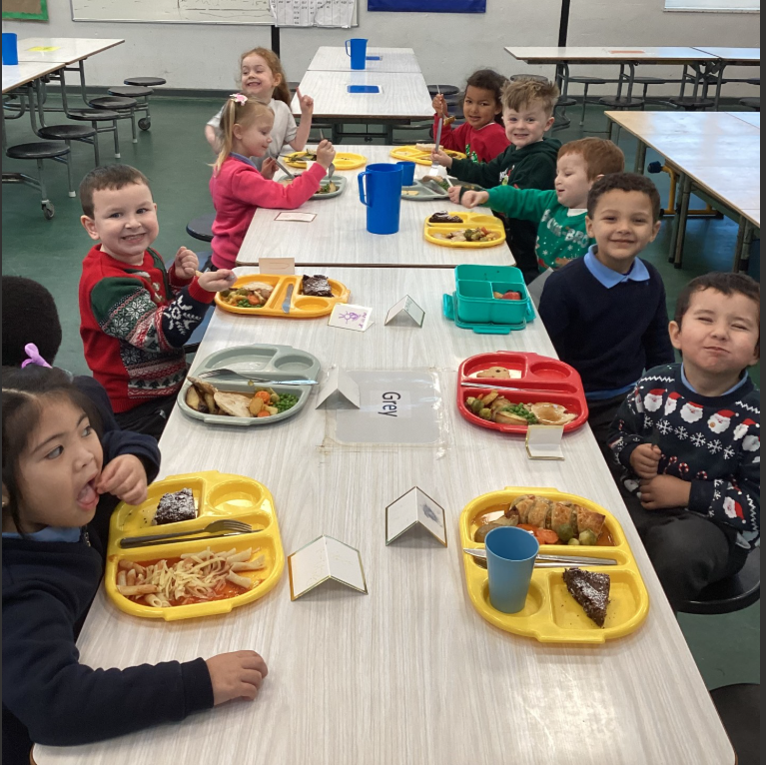

What will happen on Tuesday, 8th September
at 9.30am?
The children will stay for lunch.
We recommend the school dinners, which are ordered online through ParentPay.
Please ask at the office on Monday if you need to sign up with ParentPay.

Slide 10
Attendance
School starts at 8.30am.
School finishes at 3.10pm.
All children must be collected by a parent or known adult. If someone new is collecting your child, they must know the password you have given the office.

Slide 11
Illness
Call by 9am of day of illness.
Ring each day until your child returns.
We can administer Calpol and prescription medication. Make sure you have completed the form.
Vomiting and diarrhoea – keep off for 48 hours.
Please inform us of medical / dental appointments.
We will need to see a letter.

Slide 12

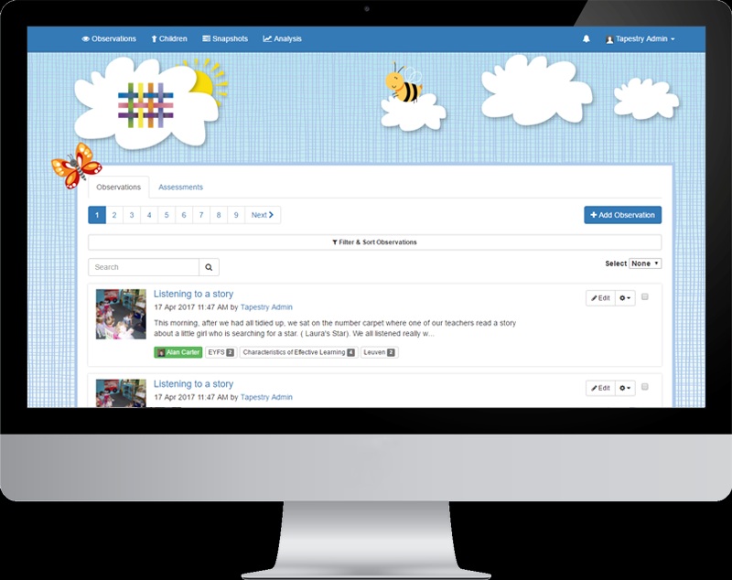
Home School Communication
For new starters:
In Reception, we use Tapestry, an online learning journal, as our main form of home school communication.
It is a lovely way of recording your child’s life in Reception, as staff upload photo observations of your child’s progress and next steps.
In September, you will automatically be signed up for Tapestry, so please look out for an activation email to set up your login and password.

Slide 13
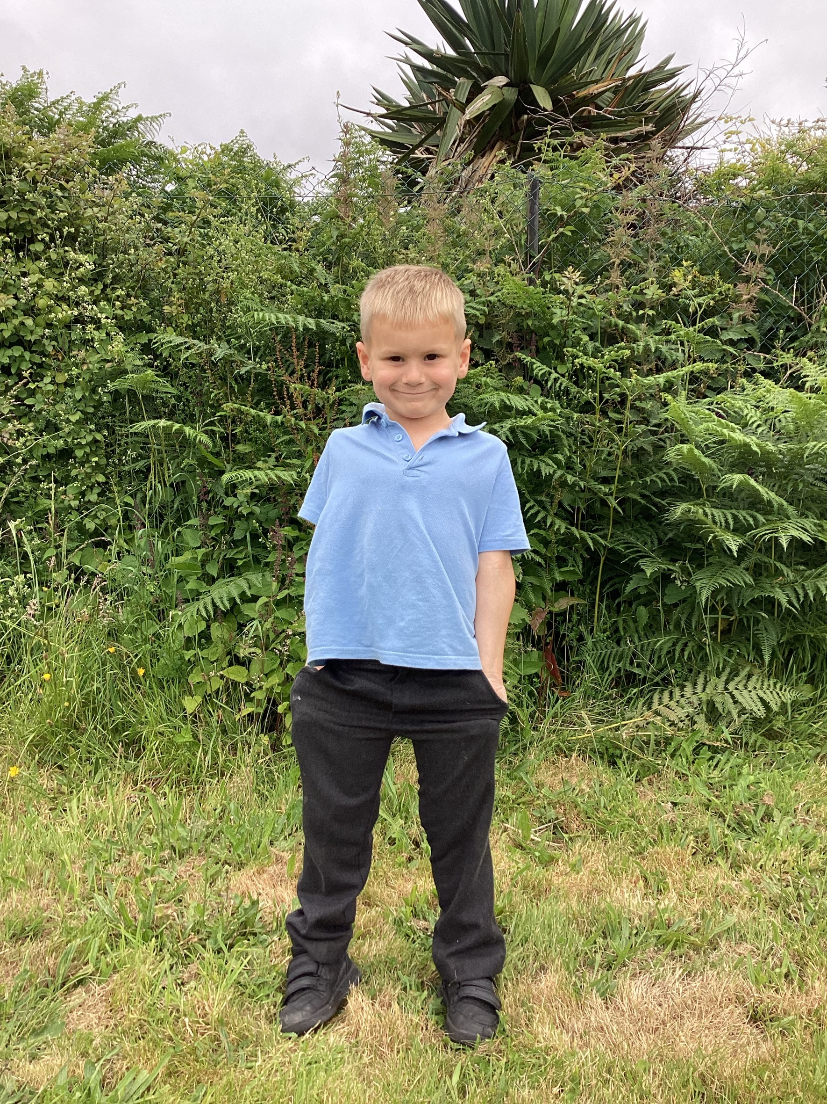
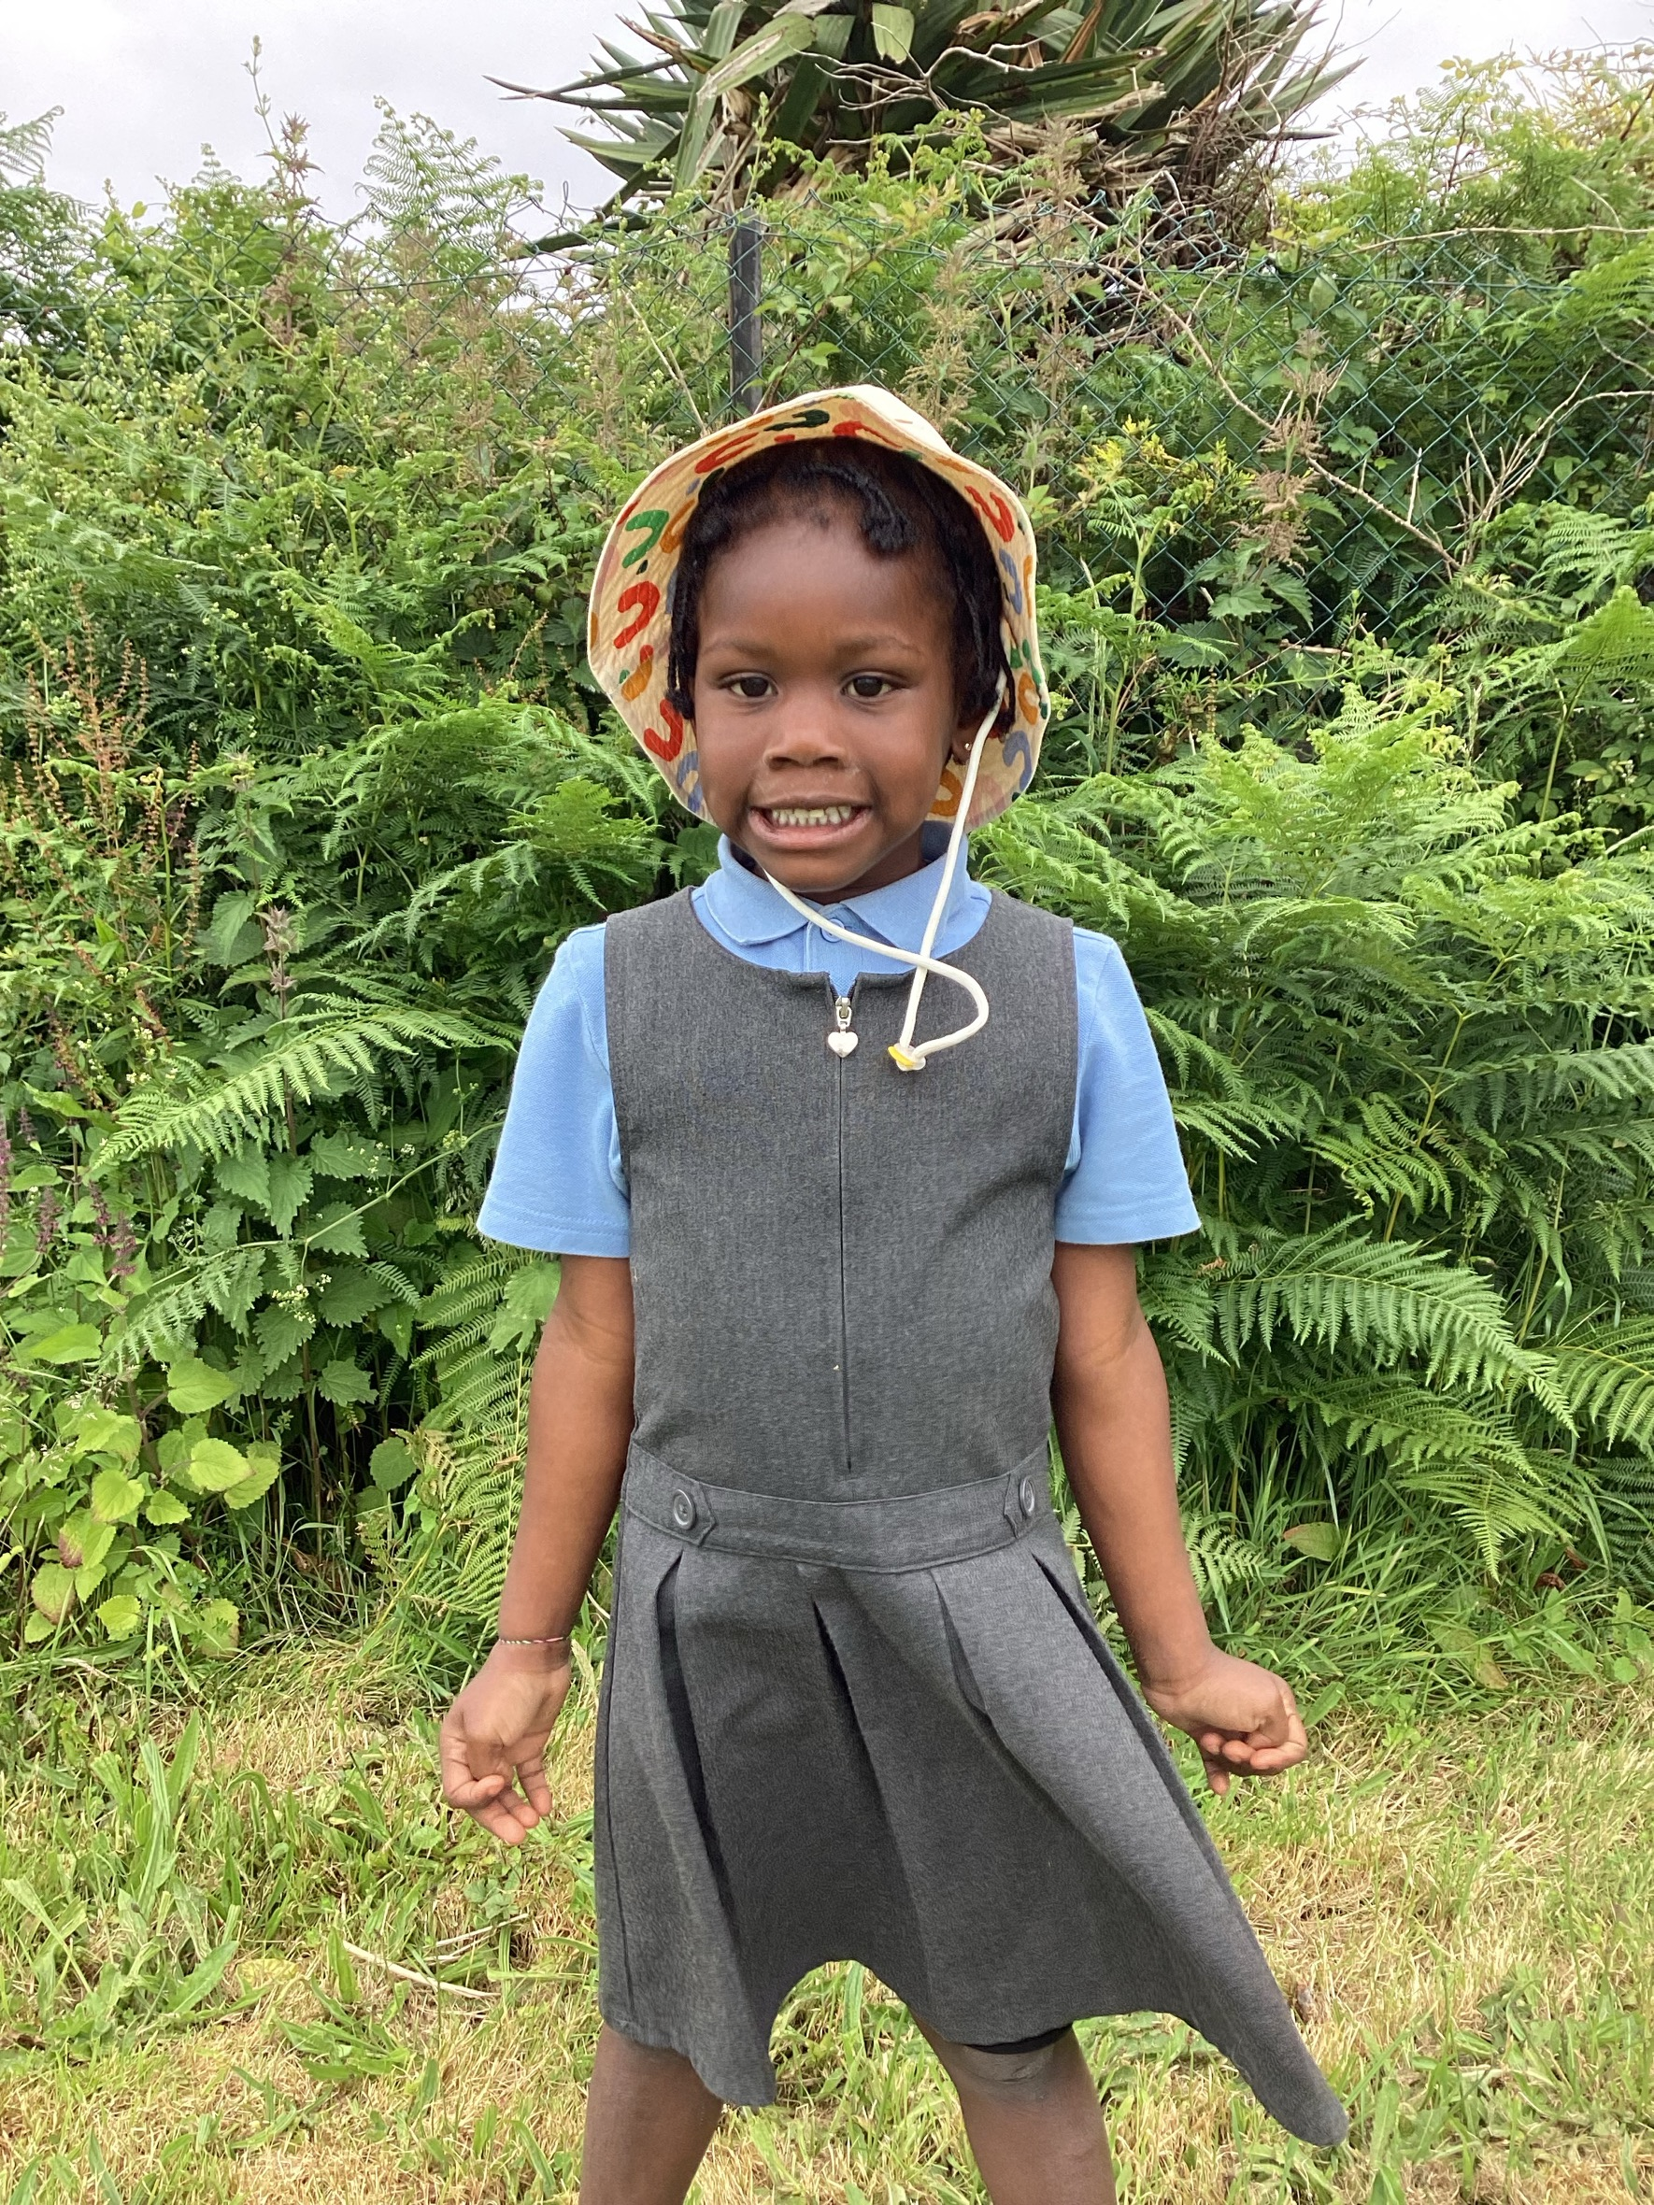
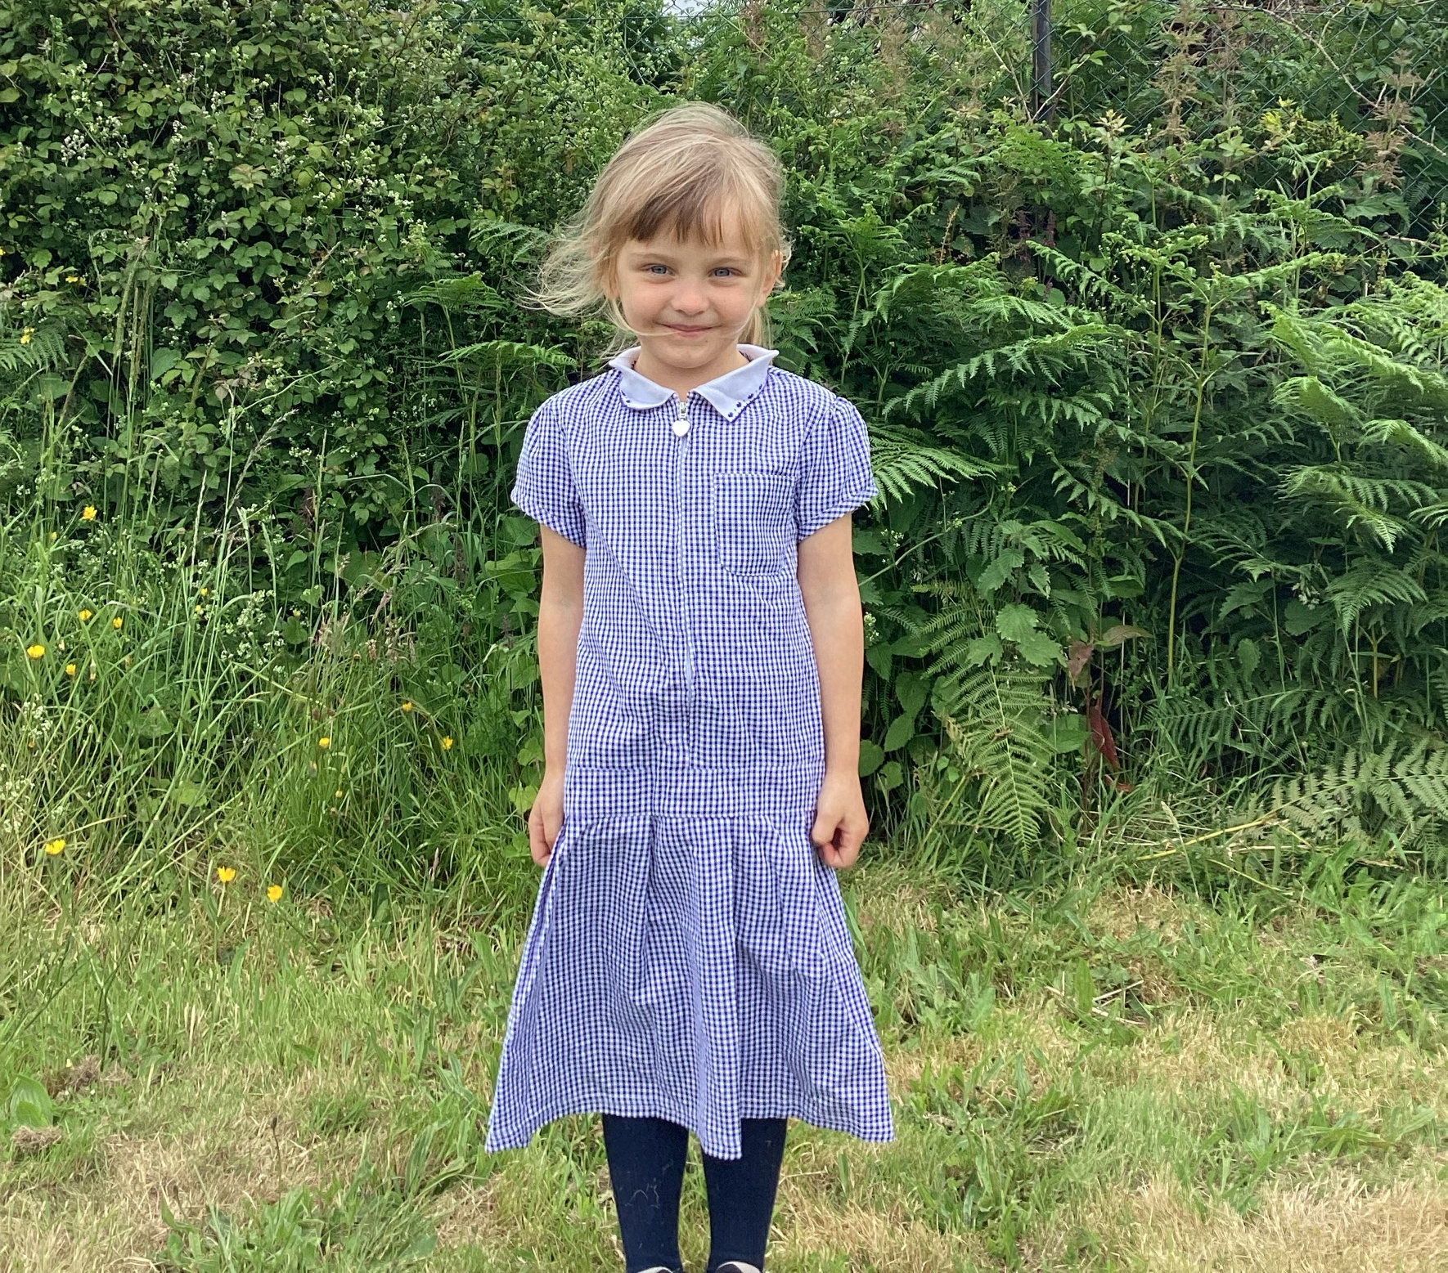
School Uniform
Uniform can be purchased from:
Truro Learning Academy Archives - Keywear Uniforms
1 Church Walk, Truro, TR1 1JH
White or light blue polo shirt.
Navy jumper or cardigan.
Grey trousers, skirt or dress.
Black school shoes (no open toes or trainers)
Summer term: Navy check summer dress.
Velcro fasteners for shoes please.

Slide 14
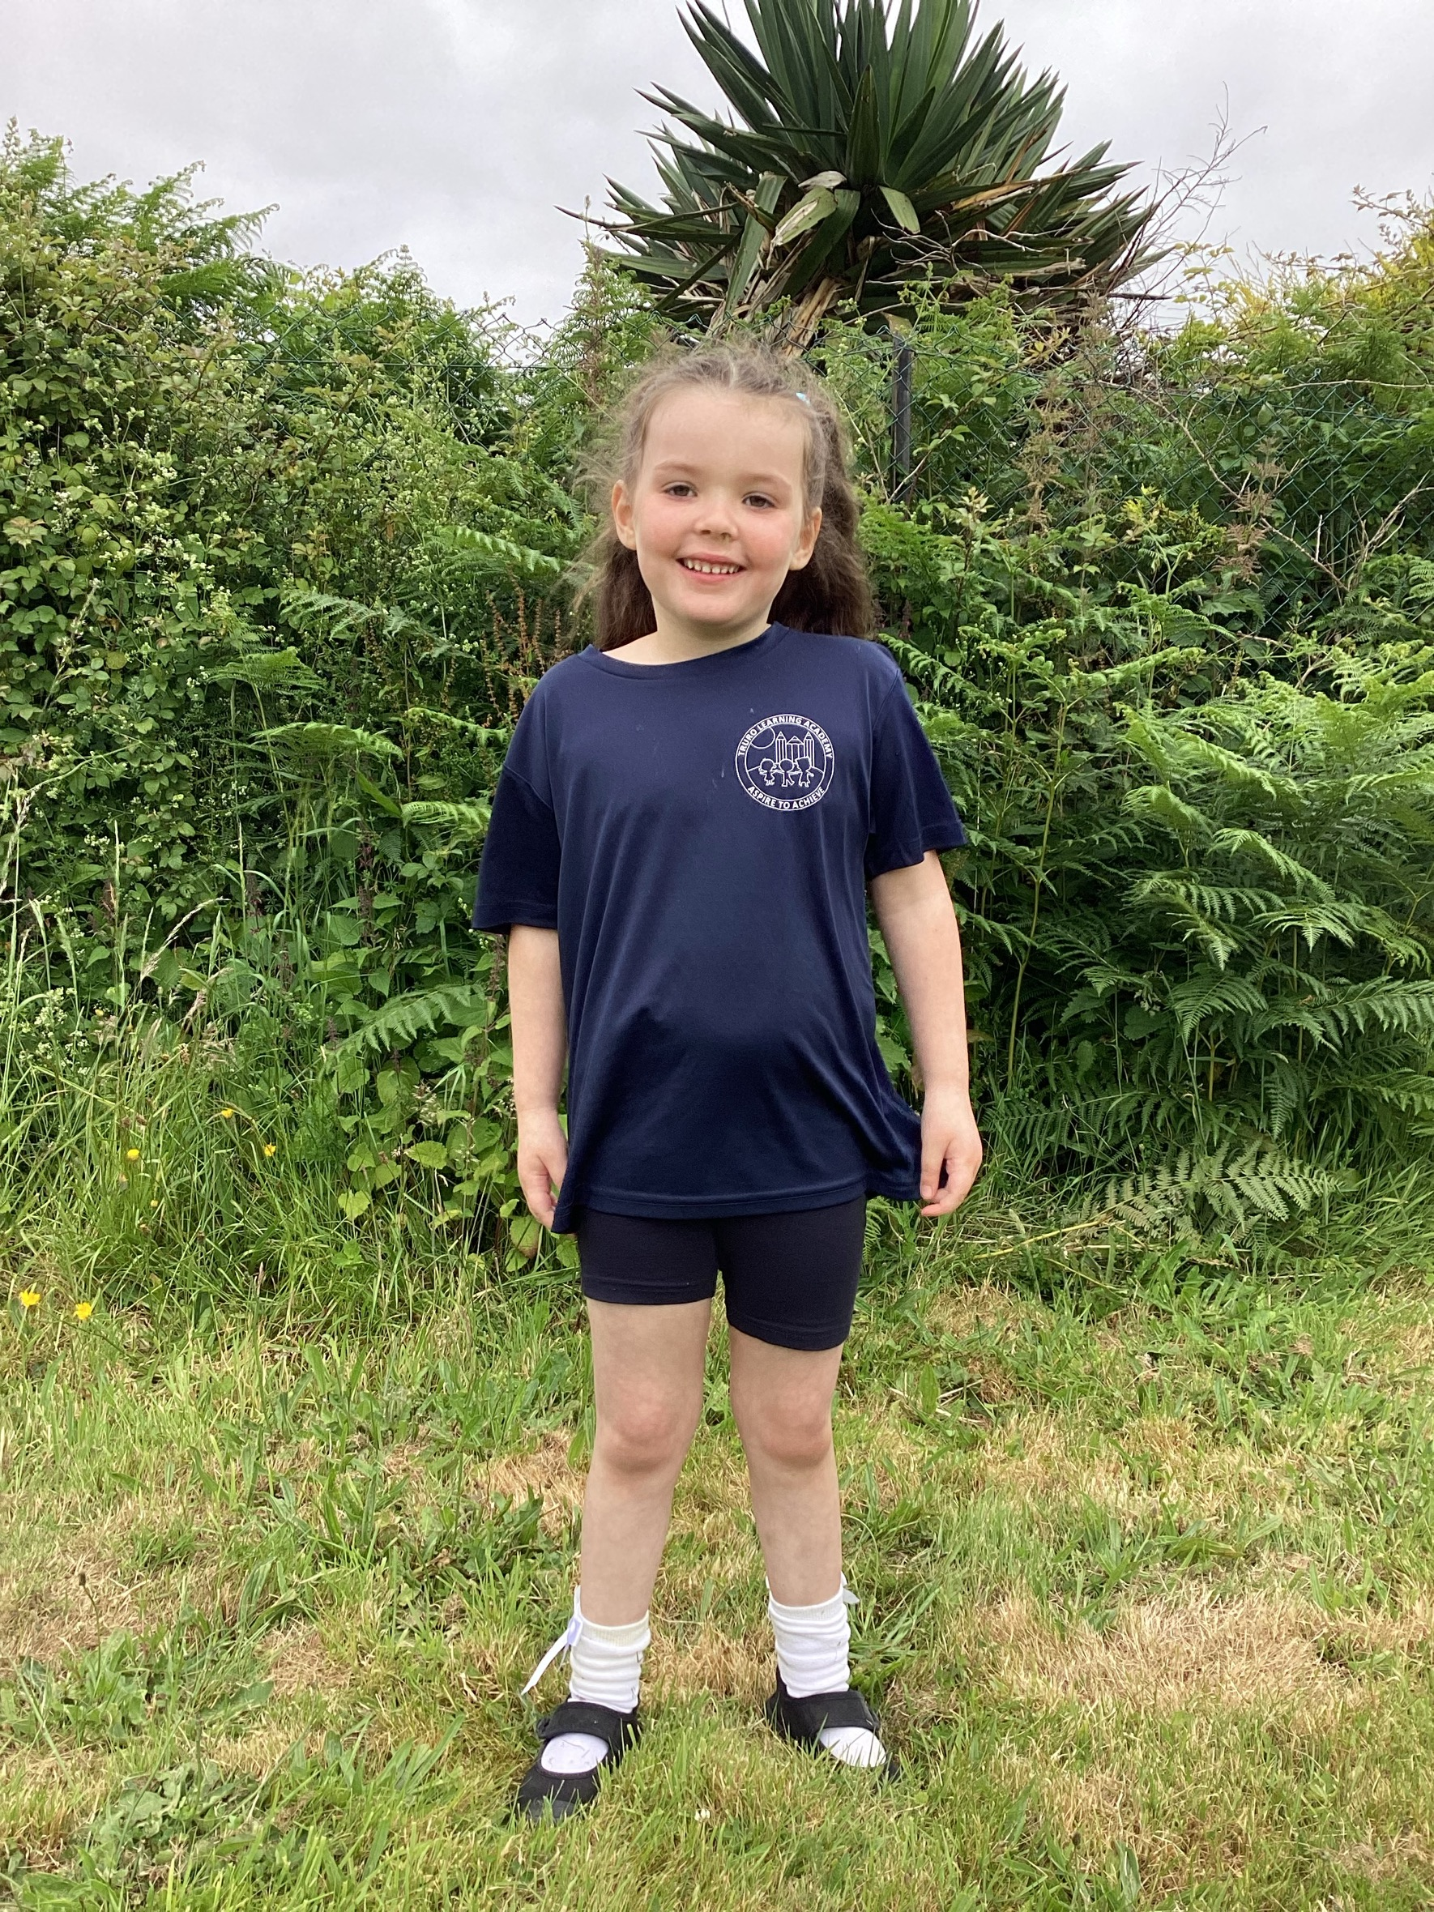
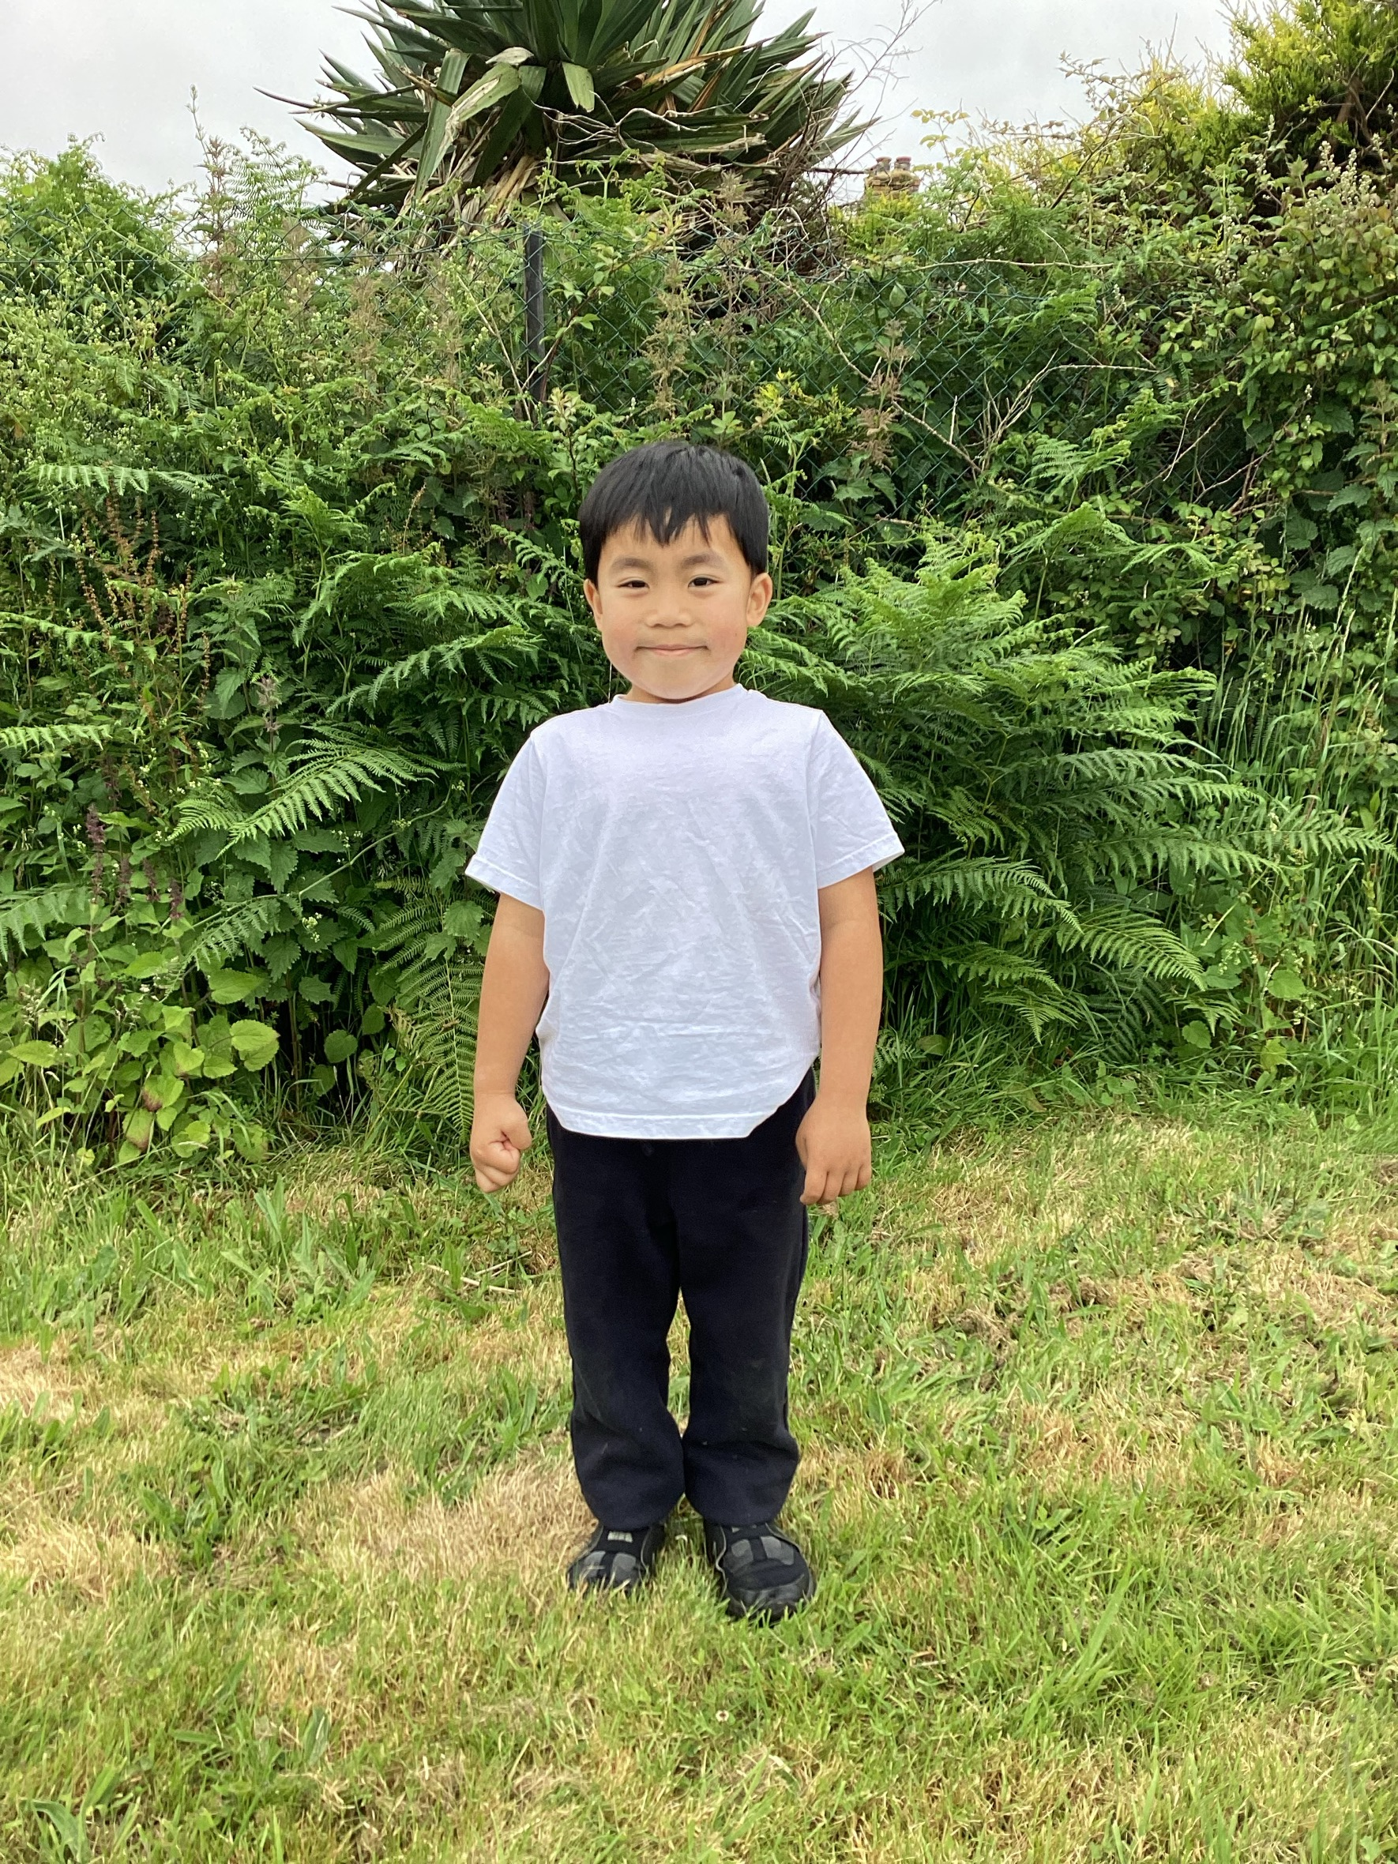
PE Kit
Truro Learning Academy Archives - Keywear Uniforms
Keywear: 1 Church Walk, Truro, TR1 1JH
Plain white or navy tee shirt.
Black shorts, leggings or jogging bottoms.
Black plimsolls or trainers.
Navy hoody.

Slide 15
Wraparound Care
Every day:
Breakfast Club: 8.00am – 8.30am
After School Club: 3.10pm – 4.40pm
Contact the office for more information and to book.

Slide 16



We learn through:

Slide 17

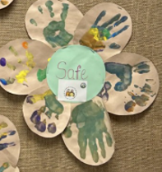
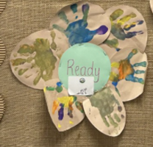
School Rules
Be kind.
Be safe.
Be ready.

Slide 18

What can I do to help my child be school ready?
Home - Starting Reception
Read the rest of the website for more information.

Slide 19
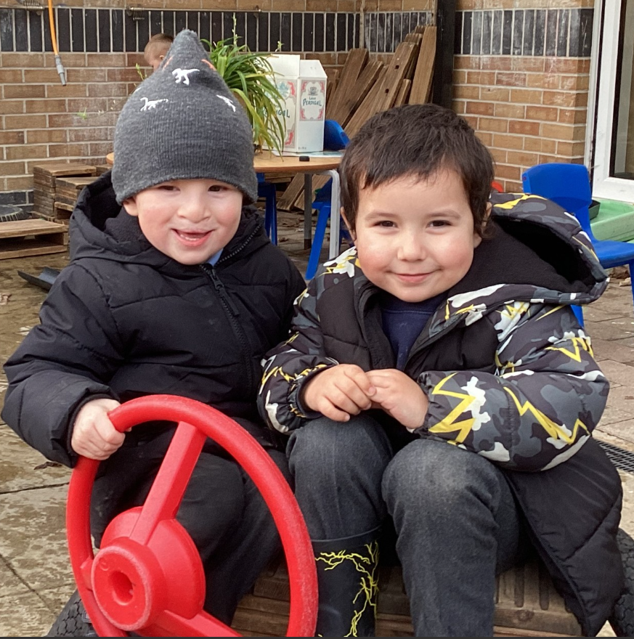
See you in September!
Any questions, email hello@truroacademy.org.uk.

